Slide 1
Software Architect Design
Final Project
POS System
HIT Team

Slide 2




Contents
Project Summary
Project Plan
POS Architecture Driver
POS Architecture Design
Demo

Slide 3
Introduction to POS System
Company A, a retail chain, has decided to develop a sales system (hereinafter, the system) in conjunction with its launch of a point service. Company A decided to choose the Web solution using ASP.NET MVC 3 framework, only Web browser, no local Database needed for any POS terminal. And authorized managers can display statistic reports from Internet.

Slide 4
Scope
HIT Team will develop POS System on web platform with following targets:
Quick Checkout: Each cashier will have a bar-code scanners. Products sold at stores have bar codes attached which indicate the product codes.
Payment Options: Company A offers payment by cash or by using loyalty point.
Control: Products are classified into product types such as food, general merchandise, etc. Not all stores carry every product type, and the range of product types carried is designated for each store.
Competitive prices: the system has capable of performing the statistical analysis on the sales records of all stores in near real-time manner.
Track product popularity and profitability.
Improve customer throughput with faster service.
Accelerate inventory turnover by being able to stock the items known to sell quickly.

Slide 5
Contents
Project Summary
Project Plan
POS Architecture Driver
POS Architecture Design
Demo

Slide 6
ACDM Stages

Slide 7
Schedule

Slide 8
Contents
Project Summary
Project Plan
POS Architecture Driver
POS Architecture Design
Demo

Slide 9
Entities
Administrator
Head Office Manager
Staff
Cashier
Member

Slide 10
Context Diagram

Slide 11
Use-case

Slide 12
Use-case

Slide 13
Business Constrains
Consideration | ID | Business Constraints.
Organizational restrictions and demands. | BC01 | One team with 6 members. Each member must work appreciate thirty hours for this project.
Market restrictions and demands | BC02 | Produced only for ABC Company
Demo | BC03 | Demo function “Sale Products”
Time | BC04 | Begin at 2/4/2012 to 5/7/2012

Slide 14
Technical Constrains
Consideration. | ID | Technical Constraints
Commercial hardware or software products. | TC01 | Bar code readers Computer SQL Server Database
Tools and methods. | TC02 | Visual Studio 2010, SQL Server Management Studio 2008. .Net Framework ASP.Net MVC 3.0
Protocols, interfaces, standards. | TC03 | TCP/IP protocol
Computer operating system(s) | TC04 | Window 7
Computer languages(s) | TC05 | C#
POS software | TC06 | Software can run on any computer with an Internet connection and web browser, without additional software.

Slide 15
Quality Attributes
Performance
Security
Availability

Slide 16
Quality Attributes
ID & Title | Stakeholder priority | Difficulty ranking | Priority
QAS1 Sale product when database at Head Office crash | 3 | 3 | 3
QAS2 Save Bill to the database | 1 | 2 | 1
QAS3 Statistic bill | 2 | 2 | 2
QAS4 Scan member Loyal | 1 | 2 | 1
QAS5 Block unauthorized access | 1 | 1 | 1
QAS6 Authority | 1 | 1 | 1

Slide 17
Quality Attribute Scenarios
Title of scenario: Crash database at Head Office |  | ID: QAS1 | Version: 1.1
 |  |  | Last Changed: 04/07/2012
Quality attribute: Availability |  | Characterization ID: QA2
Describe stakeholder role proposing the description: Cashier
Source(s) of the stimulus | Internal, External
Stimulus | Omission – Server Crash
Relevant environmental conditions | System operation normally
Architectural elements | System and the information in the system
System response | The system use information in backup database and response to admin
Response measure(s) | Response within 10 seconds
Associated risks

Slide 18
Quality Attribute Scenarios
Title of scenario: Save Bill |  | ID: QAS2 | Version: 1.1
 |  |  | Last Changed: 04/07/2012
Quality attribute: Performance |  | Characterization ID: QA1
Describe stakeholder role proposing the description: Cashier
Source(s) of the stimulus | End user
Stimulus | Send a request to save bill to the system
Relevant environmental conditions | When the system operation normally.
Architectural elements | System and the information in the system
System response | The system save information in primary database and response to client save bill success
Response measure(s) | Response within 5 seconds
Associated risks

Slide 19
Quality Attribute Scenarios
Title of scenario: Displays statistical reports |  | ID: QAS3 | Version: 1.1
 |  |  | Last Changed: 04/07/2012
Quality attribute: Performance |  | Characterization ID: QA2
Describe stakeholder role proposing the description: Manager
Source(s) of the stimulus | End user
Stimulus | Send a request to Statistics
Relevant environmental conditions | When the system operation normally.
Architectural elements | System and the information in the system
System response | The system get information in primary database and response to client
Response measure(s) | Response within 5 seconds
Associated risks

Slide 20
Quality Attribute Scenarios
Title of scenario: Scan customer |  | ID: QAS4 | Version: 1.1
 |  |  | Last Changed: 04/07/2012
Quality attribute: Performance |  | Characterization ID: QA2
Describe stakeholder role proposing the description: Cashier
Source(s) of the stimulus | End user
Stimulus | Send a request to get customer information
Relevant environmental conditions | When the system operation normally.
Architectural elements | System and the information in the system
System response | The system get information in primary database and response to client
Response measure(s) | Response within 3 seconds
Associated risks

Slide 21
Quality Attribute Scenarios
Title of scenario: Block unauthorized access |  | ID: QAS5 | Version: 1.1
 |  |  | Last Changed: 04/07/2012
Quality attribute: Security |  | Characterization ID: QA1
Describe stakeholder role proposing the description: Cashier, manager, staff
Source(s) of the stimulus | unknown identity
Stimulus | Try to access the system illegitimacy
Relevant environmental conditions | When the system operation normally.
Architectural elements | System and the information in the system
System response | The system block this request
Response measure(s)
Associated risks

Slide 22
Quality Attribute Scenarios
Title of scenario: Authority |  | ID: QAS6 | Version: 1.1
 |  |  | Last Changed: 04/07/2012
Quality attribute: Security |  | Characterization ID: QA1
Describe stakeholder role proposing the description: Cashier, manager, staff
Source(s) of the stimulus | End user
Stimulus | Login in to the system
Relevant environmental conditions | When the system operation normally.
Architectural elements | System and the information in the system
System response | The system authorize for users by account type
Response measure(s)
Associated risks

Slide 23
Contents
Project Summary
Project Plan
POS Architecture Driver
POS Architecture Design
Demo

Slide 24
Context Diagram

Slide 25
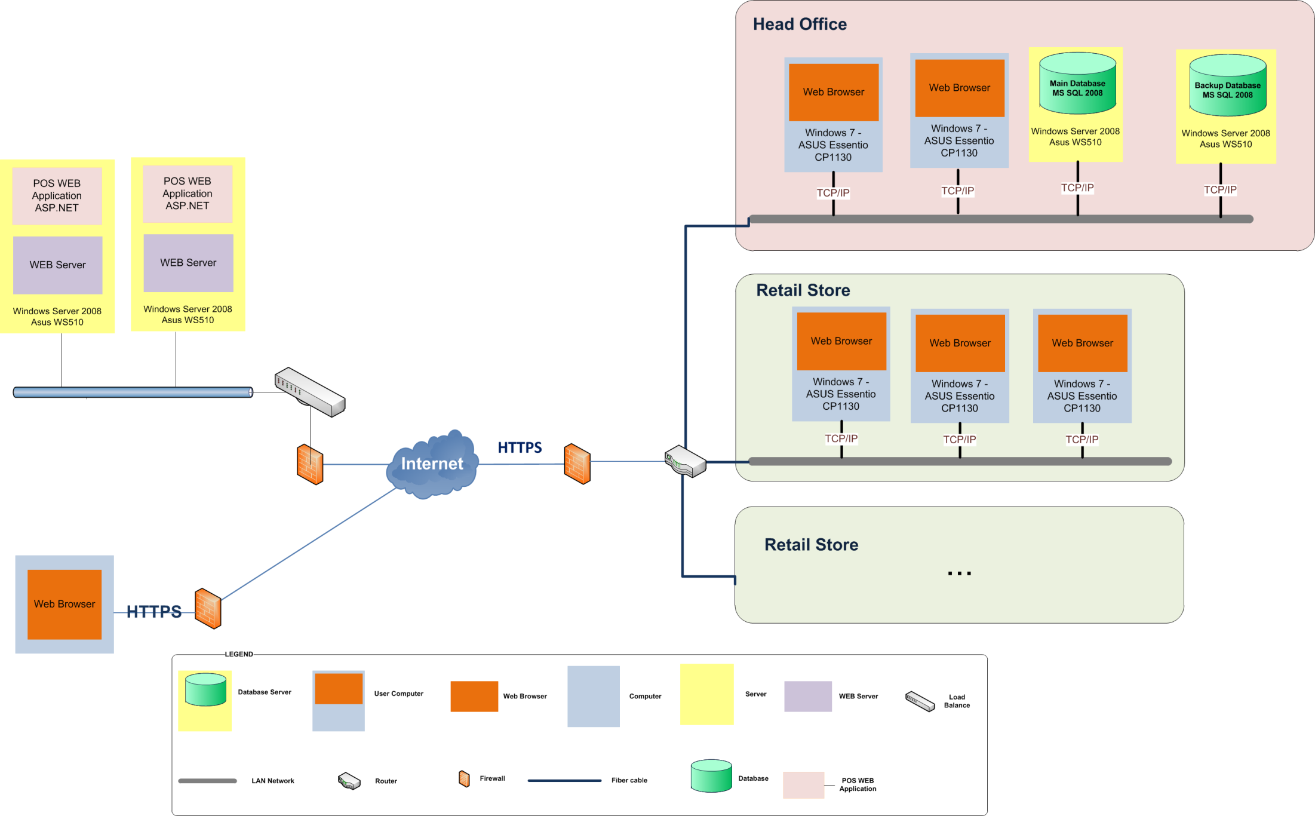
Allocation View

Slide 26
Data Model

Slide 27
Module View

Slide 28
C&C View

Slide 29
Tactics
Performance:
The system must handle requests quickly even when there are many requests
Introducing concurrency: Load balance can use to balance the requirements for the two server
Increase resources available: use two servers to be able to process multiple requests
Maintain multiple copies of either data or computations: When scanning a product code of the product, the system will get the product information and store it on a cache, in the second times scan that product, the product information will be retrieved from the cache

Slide 30
Tactics
Security:
Users want to log into the system will need to use one account and a password. Only accounts with the correct password can access the system.
Authenticate users: Verify the system's users. Administrator will be created for an account and password for each user to be granted access to the system. Each different users will have different rights in the system, working with different data, this right will be confirmed when a new account
Authorize users: Each account will have a different right in the system
When logging into the system, account information and passwords will be secured

Slide 31
Tactics
Security:
Maintain data confidentiality: using transmission Secure Sockets Layer (SSL) for a Web-based link to security information and account passwords
Information is transmitted needs to be integrity
Maintain integrity: The information is transferred outside of the contained information is also part of checksum check to ensure the information is not lost on the transmission line
The account sales staff can only log into the system from the computer in sales system
Limit access: Use the computer's MAC address to be able to prevent the sign outside the system

Slide 32
Mapping View

Slide 33
Contents
Project Summary
Project Plan
POS Architecture Driver
POS Architecture Design
Demo

Slide 34
Thanks
for your listening!

